Slide 1
15CSE302 Database Management Systems COURSE DESCRIPTION B.Tech /III Year CSE/V Semester L T P C 2 0 2 3
DBMS Team
Dr G Jeyakumar
Bindu K R
Dr Priyanka Kumar
R. Manjusha
Department of CSE
Amrita School of Engineering

Slide 2
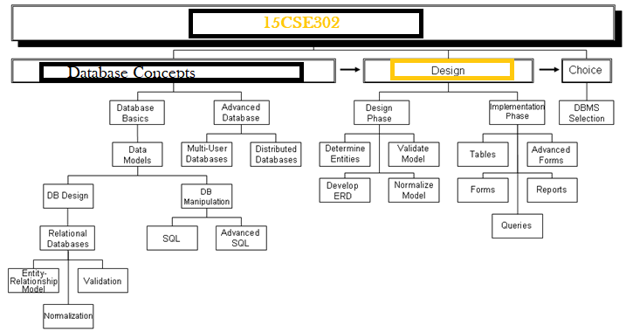
Syllabus
15CSE302 DBMS Dept of CSE, Amrita School of Engineering, Coimbatore

Slide 3

Course Objectives
List and explain the fundamental concepts of a relational database system.
Utilize a wide range of features available in a DBMS package.
Analyze database requirements and determine the entities involved in the system and their relationship to one another.
Develop the logical design of the database using data modeling concepts such as entity-relationship diagrams.
15CSE302 DBMS Dept of CSE, Amrita School of Engineering, Coimbatore

Slide 4
Course Objectives
Design and build a normalized database management system for real world applications.
Create a relational database using a relational database package.
Manipulate a database using SQL.
Assess the quality and ease of use of data modeling and diagramming tools.
15CSE302 DBMS Dept of CSE, Amrita School of Engineering, Coimbatore

Slide 5
Syllabus
Unit I
Introduction: Overview of DBMS, File Vs DBMS, Elements of DBMS.
Database Design: E-R Model, Notations, Constraints, Cardinality and participation constraints,
ER design issues, Week and strong entity sets, Reduction of ER model to relational model,
Extended ER features.
Relational Data Model: Introduction to relational model, Structure of relational model, domain, key, tuples of relational models.

Slide 6
Syllabus
Unit 2
Relational Database Design: Functional dependency
Normalization: 1NF, 2NF, 3NF, BCNF, Relational synthesis algorithm,
Lossless join testing algorithm, Decomposition using Functional dependencies,
Functional-Dependency theory
SQL: Various DDLs, DMLs and DCLs
15CSE302 DBMS Dept of CSE, Amrita School of Engineering, Coimbatore

Slide 7
Syllabus
Unit 3
Indexing Mechanisms: clustered, Non-clustered, B-tree, B+ Tree, Hash based.
Transactions: Transaction concept, Transaction model, storage structure, Transaction atomicity and durability, Transaction isolation, Serializability.
Concurrency control: Lock-based protocols – Locks, granting of locks, The two-phase locking protocol, implementation of locking, Graph-based protocols.
Deadlock handling: Deadlock prevention, Deadlock detection and recovery.
15CSE302 DBMS Dept of CSE, Amrita School of Engineering, Coimbatore

Slide 8
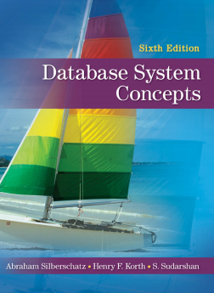
Syllabus
Text Book:
Silberschatz A Korth H F and Sudharshan S , “Database System Concepts”, 6th Edition, TMH publishing company limited, 2011.
6th edition: https://www.db-book.com/db6/index.html
7th edition: https://www.db-book.com/db7/index.html
15CSE302 DBMS Dept of CSE, Amrita School of Engineering, Coimbatore

Slide 9
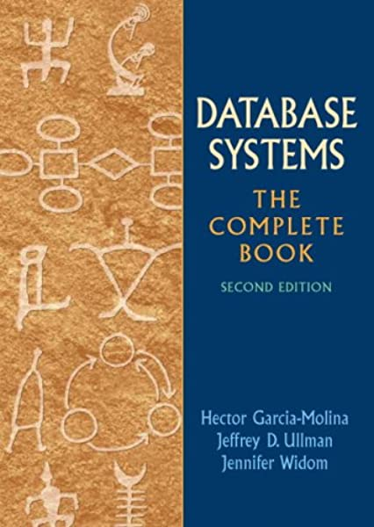
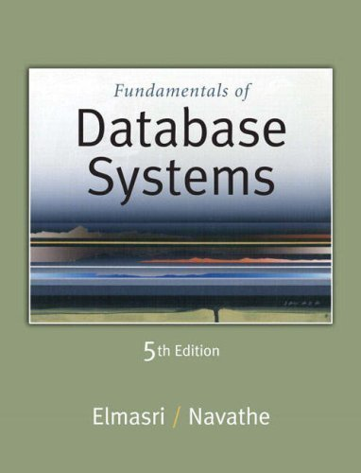
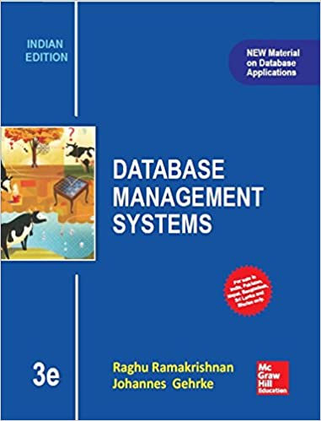
Syllabus
References
Hector Garcia-Molina, Jeffrey D Ullman, Jennifer Widom, ‘Database System ; The complete book”, 2nd Edition, 2011.
Elmasri R and Navathe S B, “Fundamentals of Database Systems”, 5th Edition, Addison Wesley, 2006.
Ramakrishnan R and Gehrke J, “Database Management Systems”, 3rd Edition, TMH, 2003.
15CSE302 DBMS Dept of CSE, Amrita School of Engineering, Coimbatore

Slide 10
Course Outcomes
COs | Course Outcome | Bloom’s Taxonomy Level | No of Hours
CO 1 | Understand the fundamentals and architecture of database systems. | L2 | 6
CO 2 | Formulate and apply relational algebraic expressions, SQL and PL/SQL to query relational databases. | L3 | 22
CO 3 | Design and build ER models for real world applications. | L4 | 9
CO 4 | Design and build a normalized database management system for real world applications. | L4 | 9
CO 5 | Apply database access control and understand transaction processing and concurrency. | L3 | 14
 |  | Total | 60
15CSE302 DBMS Dept of CSE, Amrita School of Engineering, Coimbatore

Slide 11
Evaluation Criteria
 | Component | Count | Contribution
Internal 70% | Quiz, Activity and Homework Assignment | 10 | 20%
 | Lab Evaluation | 5 | 20%
 | Project Review | 2 | 30%
External -30% | Online Examination (15%) + Group Project(Final)(15%) (Review, Viva and Documentation) | 1 | 30%
15CSE302 DBMS Dept of CSE, Amrita School of Engineering, Coimbatore

Slide 12
Evaluation Criteria
Project Based Course - Quiz + Lab Evaluation + Group Project
Total Marks: 100
Continuous Assessment 70 Marks
a. Quiz 20 marks
b. Lab Evaluation 20 marks
c. Project Review with
Demo, Viva(Project + Theory)
and Documentation 30 marks
End semester 30 Marks
Online Exam 15 marks
Viva 15 marks
15CSE302 DBMS Dept of CSE, Amrita School of Engineering, Coimbatore

Slide 13
Tools used
Dia for ER diagram
RelaX Tool for SQL to RA and RA to SQL
Normalization Tool for normalizing tables.
LiveSQL online platform
Evaluation Lab in HackerRank
Quizzes in Teams , AUMS, AMPLE, Mentimeter and Kahoot.

Slide 14
Group Project
This course has a substantial group project component.
The project will be launched the third week of class, and there will be deliverables due throughout the semester.
Students can form groups of four or five.
Further details will be available on the launch day, but the main idea of the project is to design a data model and build a database-driven web application.
Since the focus of this class is on databases, not on web programming, we will be minimizing the complexity of the web side of the project and keeping the focus on how to write real applications that work with a database
15CSE302 DBMS Dept of CSE, Amrita School of Engineering, Coimbatore

Slide 15
Lab Sessions
Practice Sessions -LiveSQL
https://livesql.oracle.com/apex/f?p=590:1:6586998004394::NO:RP::
Lab Evaluation
https://www.hackerrank.com/lab-1-1593015446
15CSE302 DBMS Dept of CSE, Amrita School of Engineering, Coimbatore

Slide 16
Summary
Course Content
Evaluation Pattern
Online Tools used
15CSE302 DBMS Dept of CSE, Amrita School of Engineering, Coimbatore

Slide 17
Thank You
Happy to answer any questions ! ! !
Notes:
Not covering all.

Slide 18
Resources:
https://md.ekstrandom.net/teaching/cs4332-f15.pdf
https://https://bit.ly/31eE2Ar
Images Courtesy
https://www.bmc.com/blogs/dbms-database-management-systems/
https://blogs.bmc.com/wp-content/uploads/2016/06/database-blue.png

